Slide 1
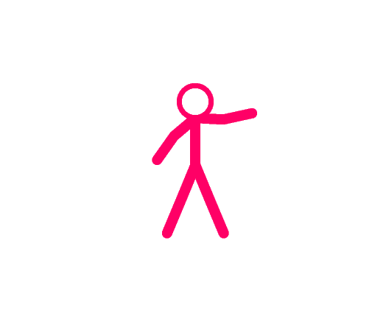
This is Susan.

Slide 2
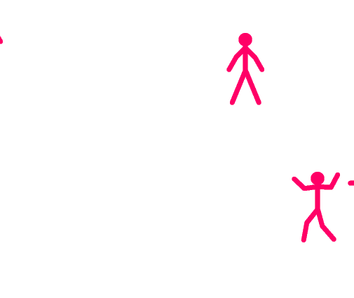
Everyday at recess Susan played tag with her friends, and they always had fun.

Slide 3
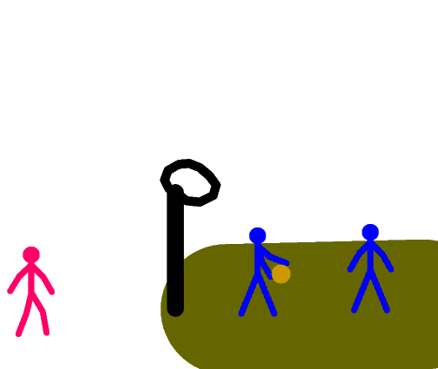
One day Susan wanted to play basketball.
At recess she walked over to the basketball court

Slide 4
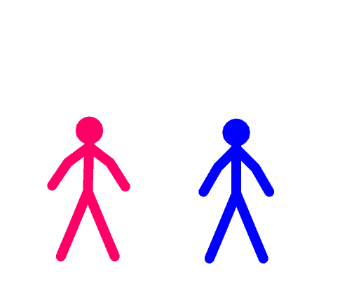
Susan asked the boys if she could play basketball.

Slide 5
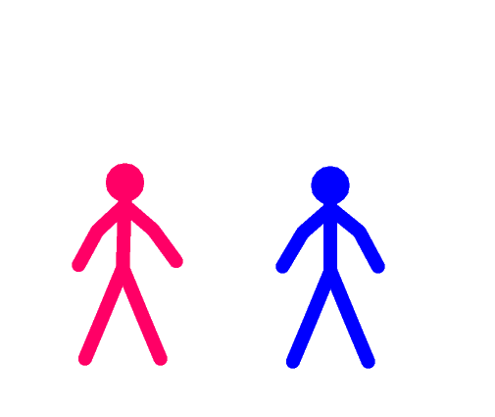
One of them said, “Don't be silly! you can't play basketball!”

Slide 6
Susan frowned and said, “Why not, you play basketball.”

Slide 7
He responded “Yes, but I'm a boy. Boys play basketball and soccer. You're a girl. Girls play tag and with dolls.”

Slide 8
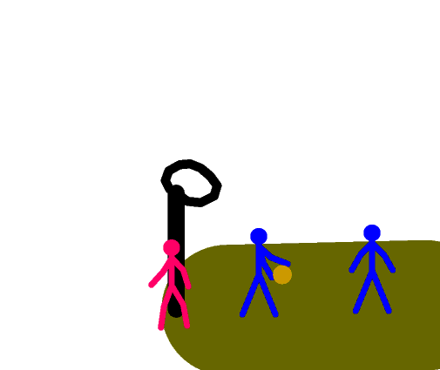
The boys continued their game and Susan walked away thinking, “I could play basketball!” so she came up with a plan.

Slide 9

The next morning Susan cut her hair short and took one of her brother's shirts before going to school

Slide 10
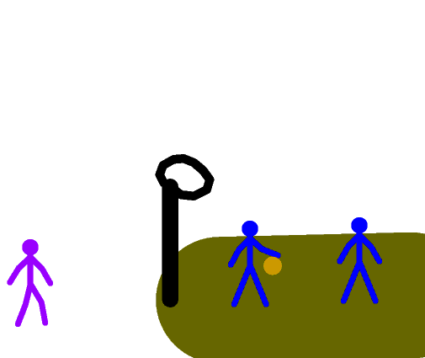
At recess she walked over to the basketball court and asked if she could play.

Slide 11
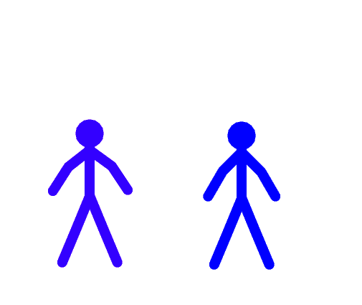
The boy looked her up and down and asked “you're new here aren't you? Do you know how to play?”

Slide 12
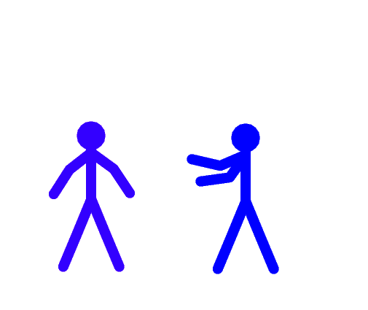
She responded, “no I don't know how, could you teach me?”
And the boys agreed to teach her

Slide 13
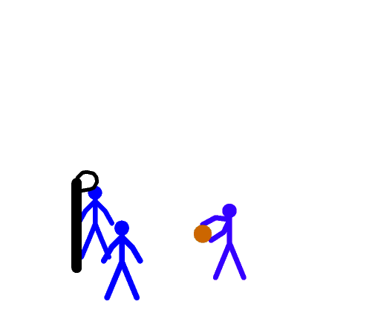
So that recess the boys taught Susan how to play basketball.
By the bell rang she was very good at basketball.

Slide 14
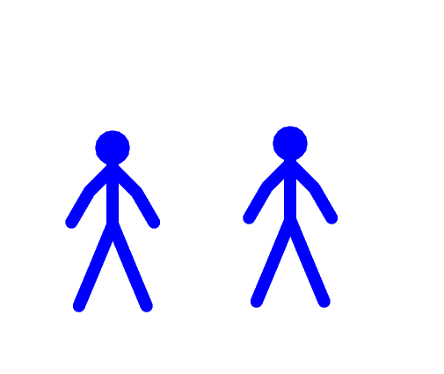
Just before she went inside a boy asked her, “Hey I didn't catch your name.” She answered “Susan.”

Slide 15
The boy started laughing “Haha you have a girls name!” and she said “that's because I am a girl.”

Slide 16
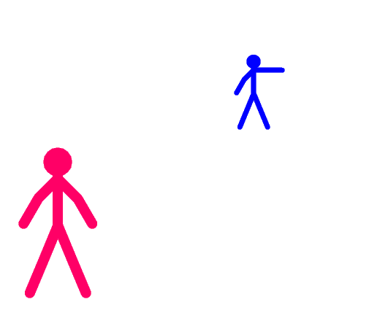
The next day at recess she was playing tag near the basketball court when she heard someone call out “Hey Susan!”

Slide 17
It was the boy, he asked her if she wanted to play basketball
She said “I'd have more fun playing with my friends!”

Slide 18
the boy said “they can come play too, we will teach them how to play.”

Slide 19
And after that the boys played against the girls every recess. The girls won most of the time.
The End

